Slide 1

GOAL NET ZERO

Slide 2

Team
Ashwin Gupta
Mouli Bhatnagar
Priya Singh
Rashi Agrawal

Slide 3
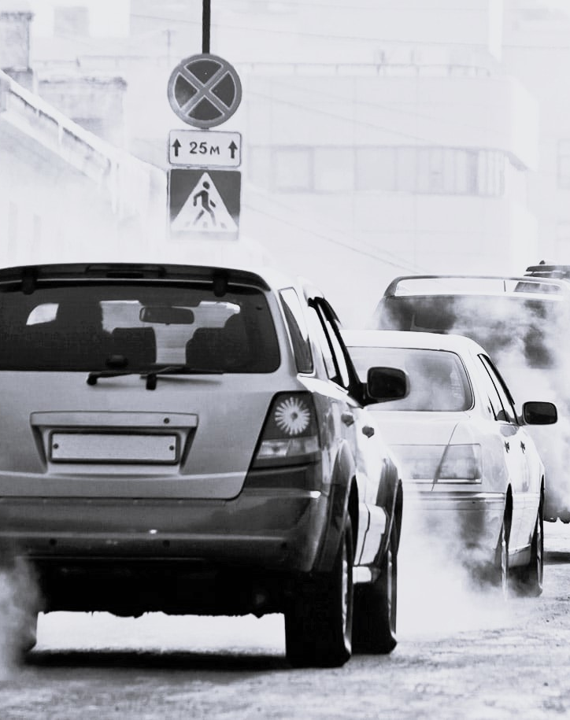
Challenge statement
CO2 EMISSION
The level of greenhouse gases in the atmosphere have increased, causing the Earth's temperature to rise.
One greenhouse gas in particular, carbon dioxide (CO2) has steadily increased over the past century due to fuel used in various types of transportation.

Slide 4
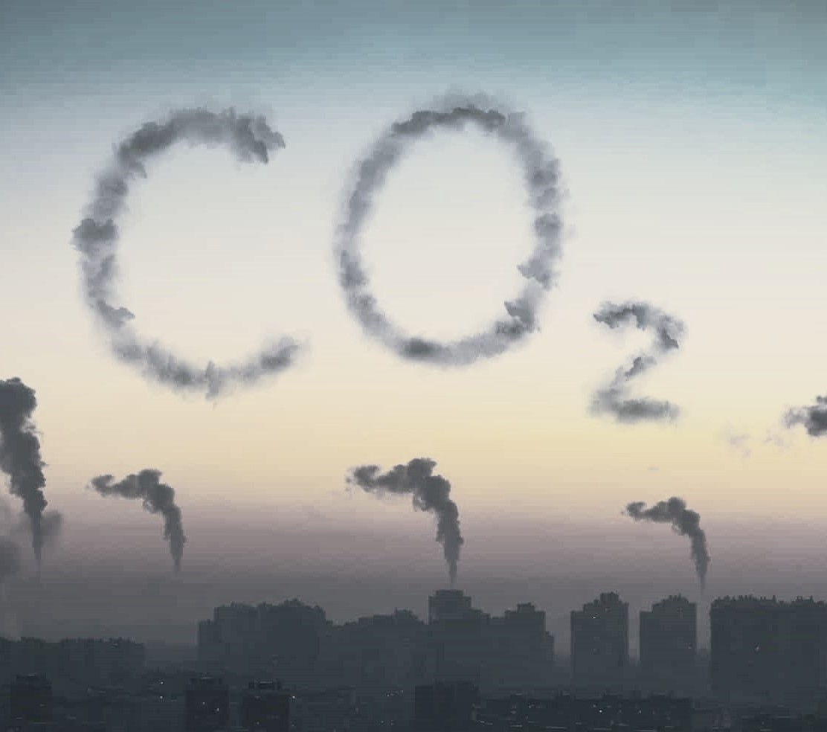
solution
awareness
Since carbon dioxide is so harmful for our environment, we are trying to aware people about how much carbon is emitting through their different choices of fuels and transport.
For that we have created a website which will help people to calculate the carbon emission occur due to travelling.

Slide 5

System architecture
technology
User interface: Login , Signup and Calculator using React and JavaScript.
Web server : Local Host :3000
Database Server : PostgreSQL
Web API : ASP. Net core web API
Backend : C#

Slide 6
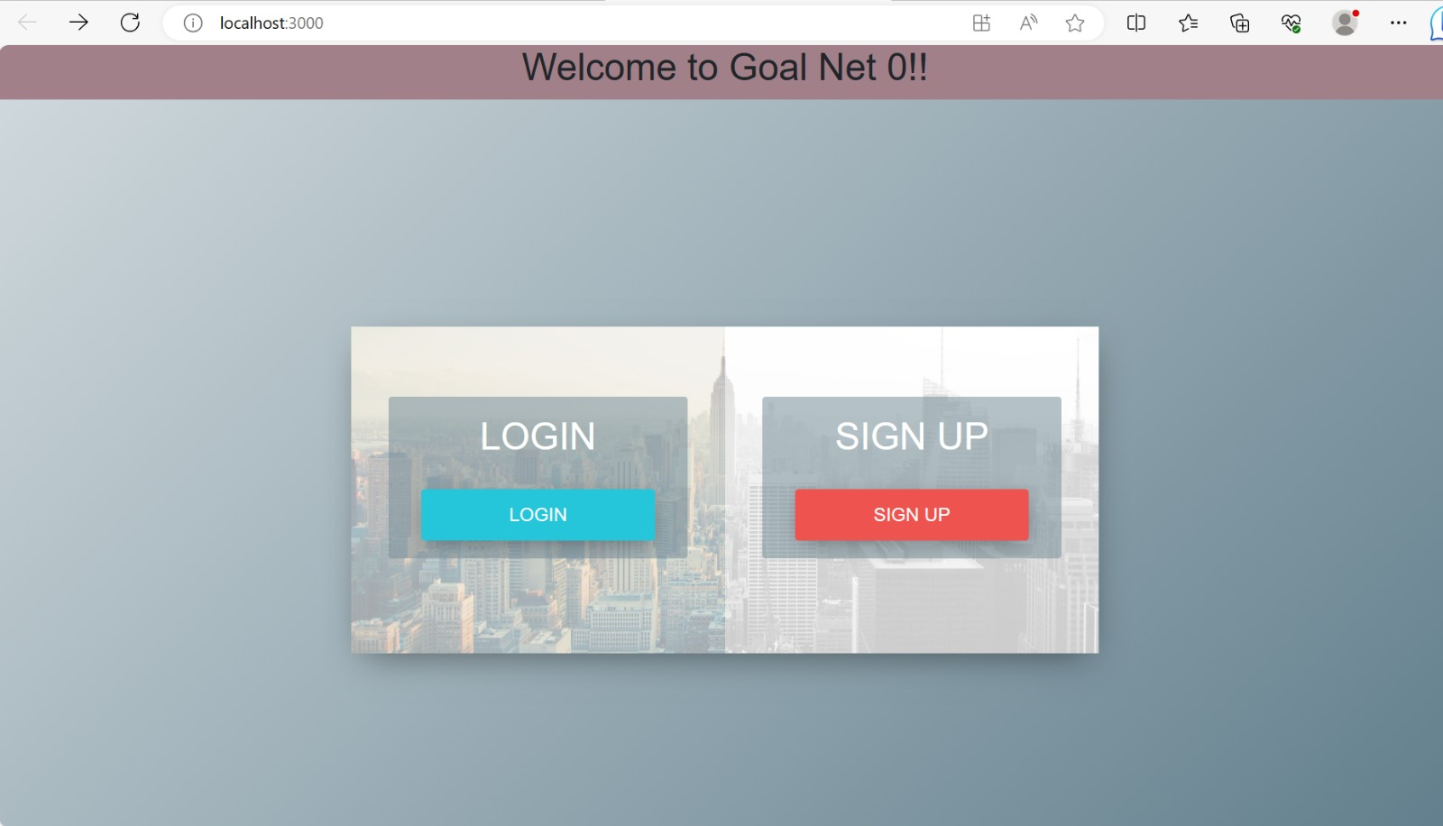

Slide 7
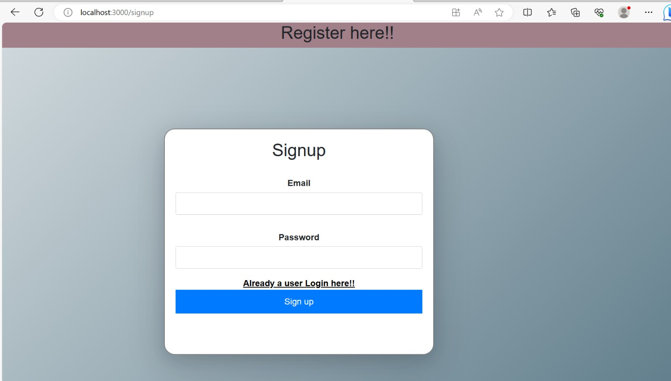

Slide 8
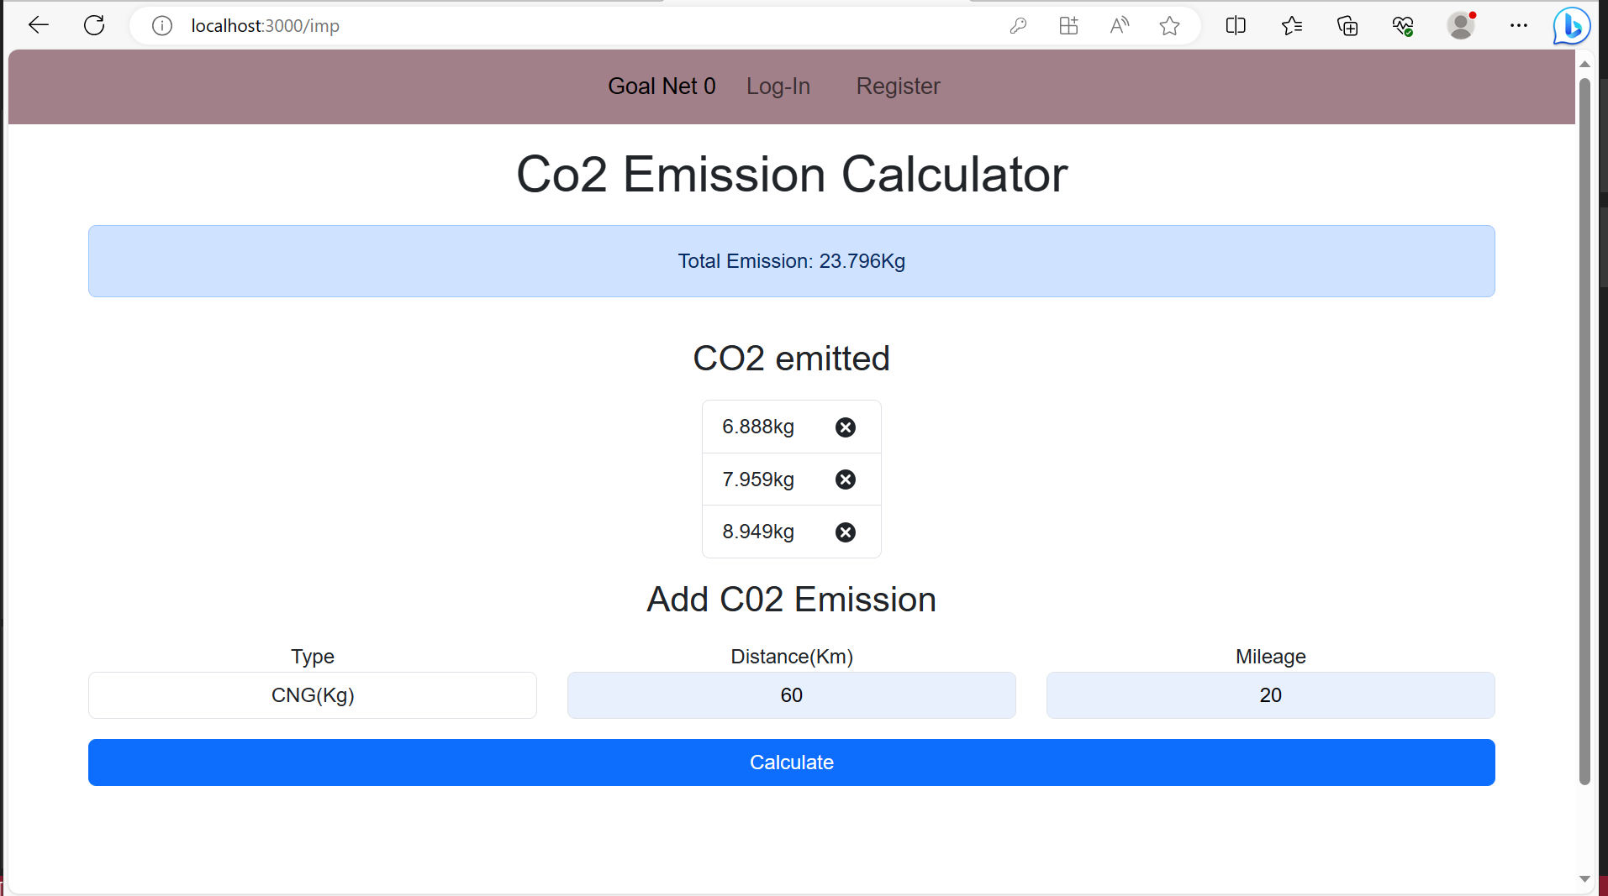

Slide 9
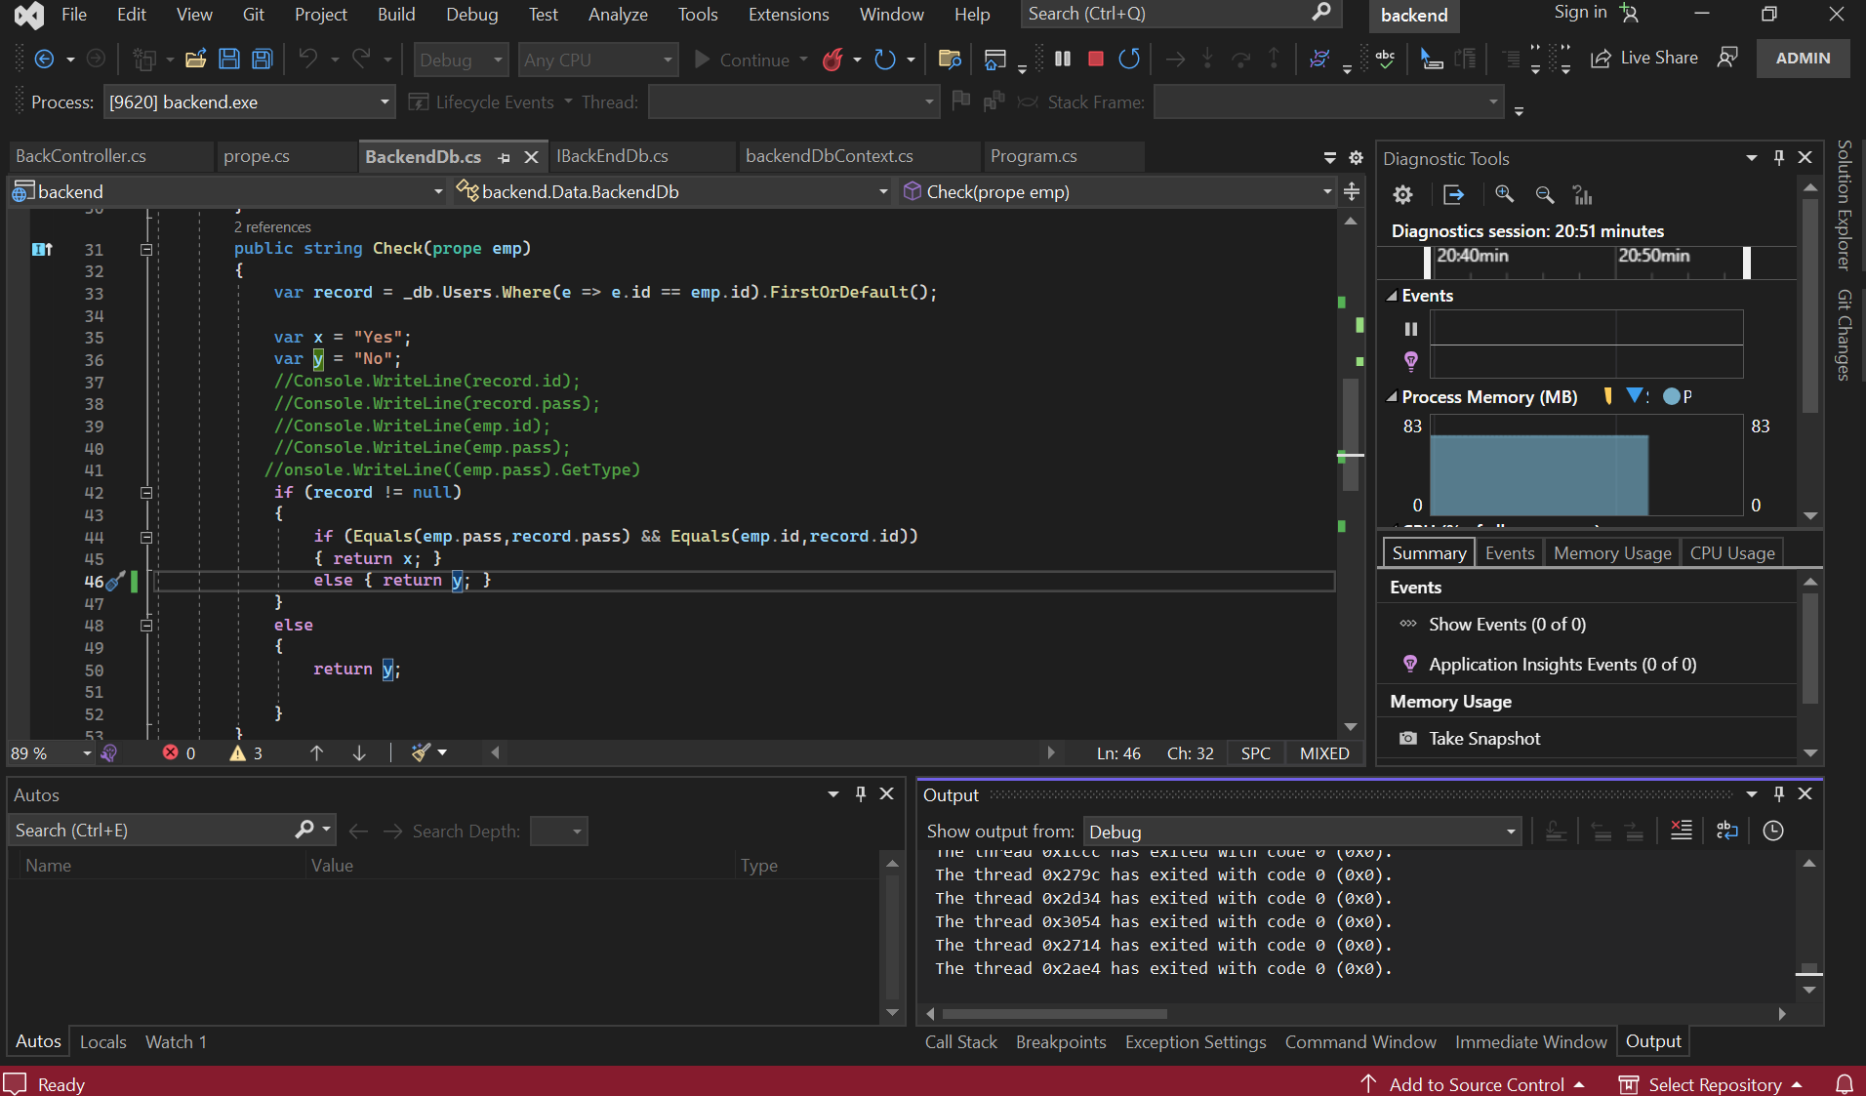

Slide 10
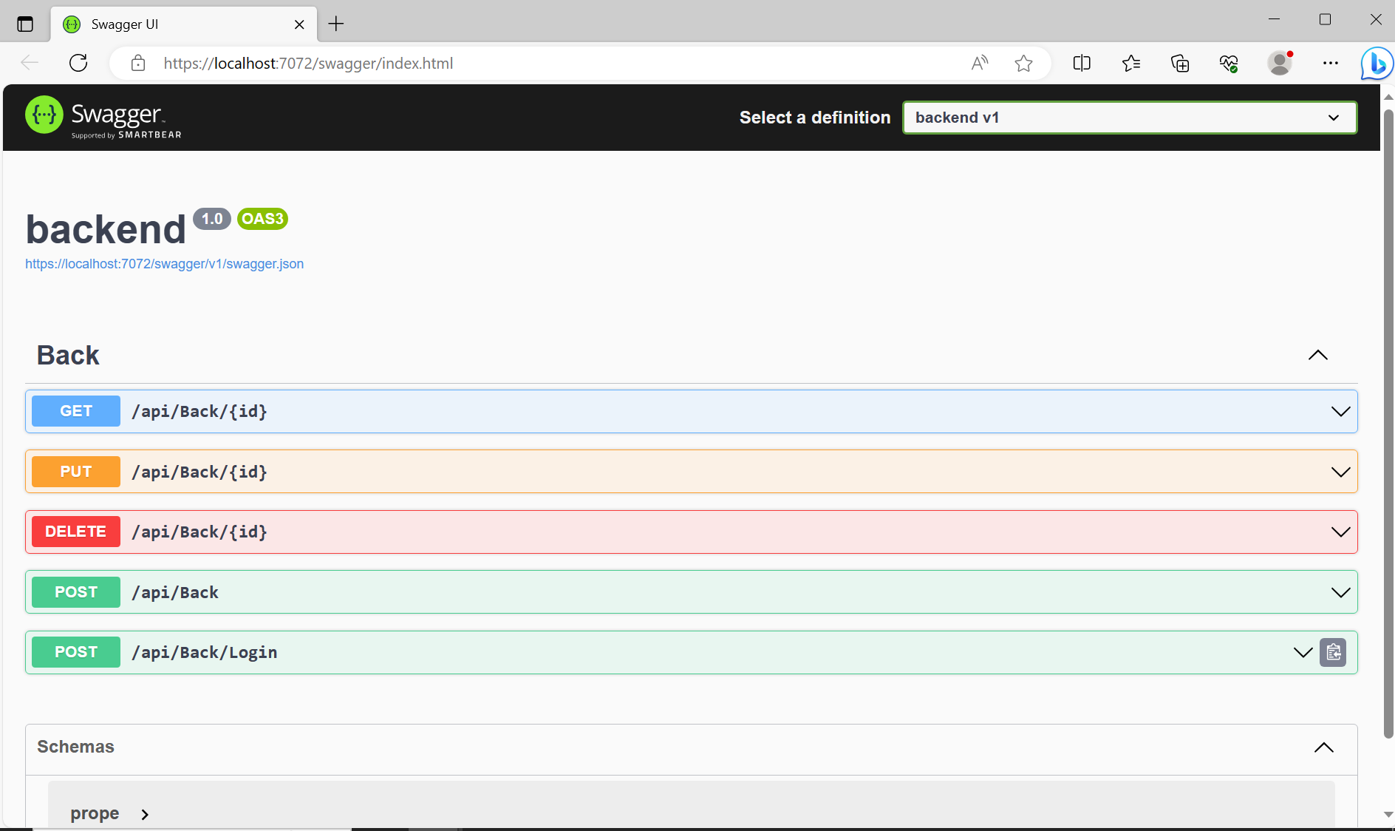

Slide 11
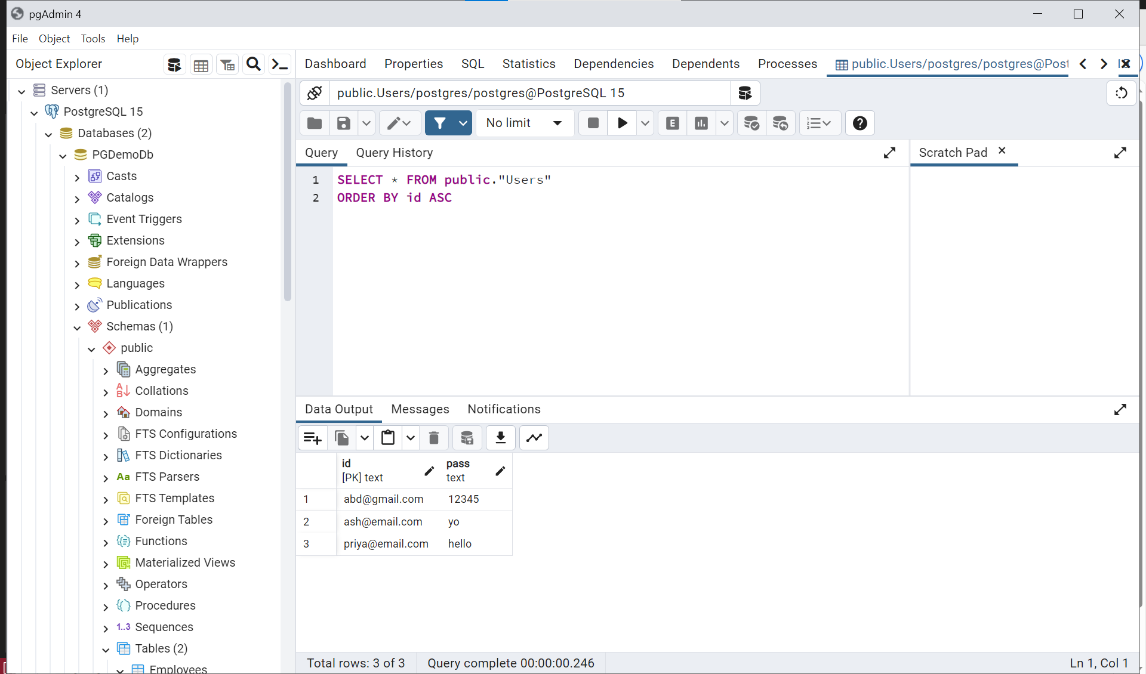

Slide 12

Future Scope
Suggest various measures to reduce carbon emissions .
Data visualization for comparing carbon emission on a daily basis depending on different types of fuels.
Different articles for awareness about how it is affecting our environment.

Slide 13
THANK YOU

